Slide 1

Premier League 2020-21
Team home runs only:
Andrew Cowan, Daniel Fernandez, Kadien Peart, Rashmi Rekha

Slide 2
Project Scope
Our project was based around a Kaggle database containing statistics for the 2020-21 Premier League season
This database was the best because of the depth and breadth of statistics
We chose to load the full table in our PostgreSQL database and pare down the data called there to provide for our web diagrams

Slide 3
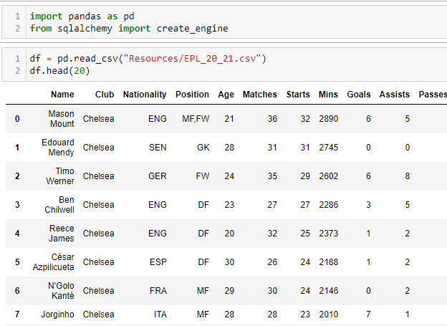
Technical Processes – Extract
Loading the CSV into a Jupyter notebook for cleanup and transformation

Slide 4


Technical Processes - Transform
Querying DataFrame to pull out category leaders

Slide 5
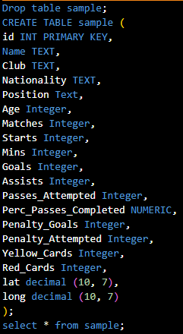
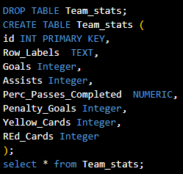
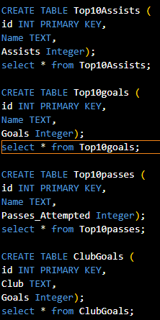
Technical Processes - Load
Creating PostgreSQL database

Slide 6
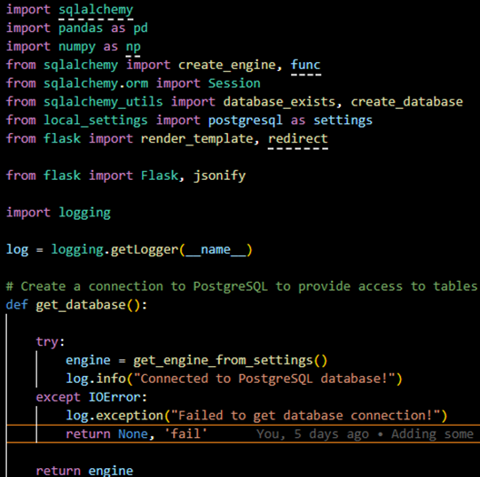
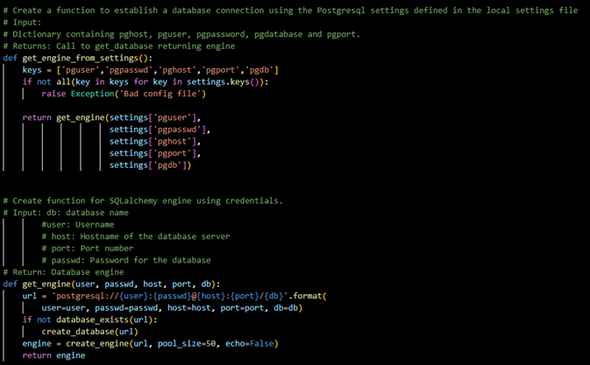
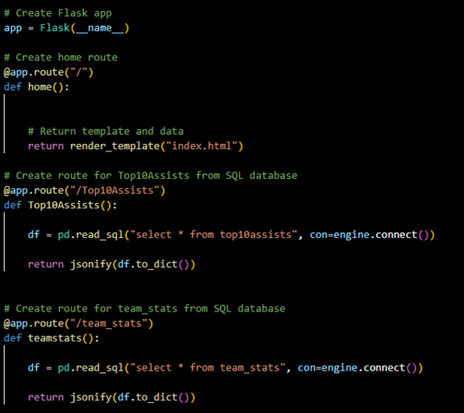
Technical Processes - Flask
Flask application to load data into the website

Slide 7
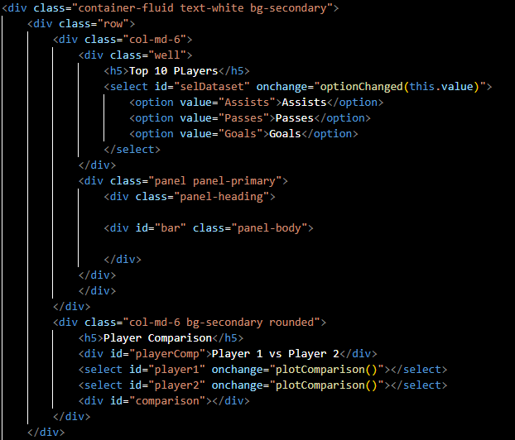
Technical Processes - HTML
HTML structure

Slide 8
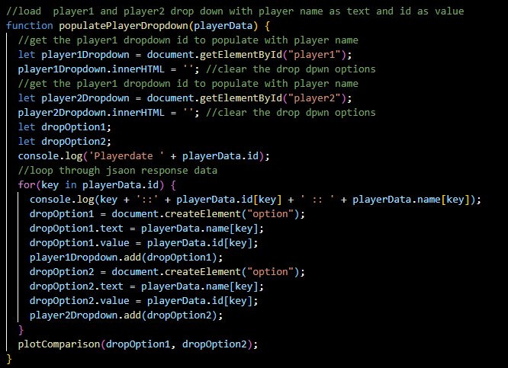
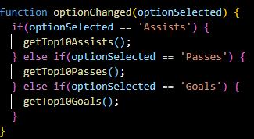
Technical Processes - JavaScript
JavaScript Libraries used: Leaflet, D3, MagicMouse.js

Slide 9
Technical Challenges
Flask to JavaScript connection was complicated and complex
Generating Selectors for Top 10 tables and player comparisons proved to be more of a challenge than anticipated
Compiling data for each country in the database was extraordinarily difficult at times
The originally-intended map proved to be incompatible with the final product, so we decided to change to a bubble chart

Slide 10
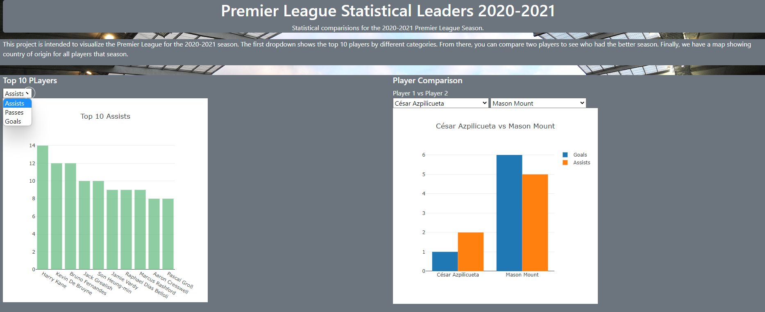
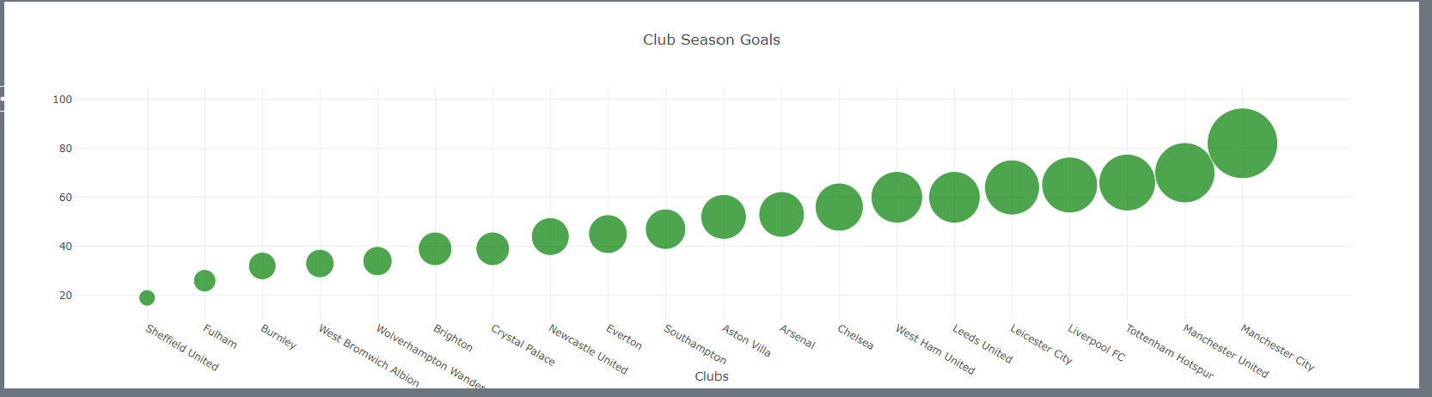
Final Product
Bar Chart
Bar Chart Comparison
Bubble Chart

Slide 11
Final Product
LIVE DEMO OF WORKING SITE

Slide 12
Any Questions?

Slide 13
Acknowledgments
A huge thanks to Rashmi’s husband for all of his suggestions and help

